Slide 1


Customer and Social Analytics
Customer Segmentation with RFM
Team 4B
Bavitra Sruthi Saravana Muthu
Dandan Zhou
Mengting Tang
Sharada Sarangan
Yida Xu
BANA 277 Winter 2023

Slide 2

Customer and Social Analytics
Agenda
1
Introduction
5
Clustering
2
EDA and Data Clearning
6
Segments and Strategy
3
Concept of RFM
7
Future Scope and Limitations
4
Elaborate on RFM
8
Q&A

Slide 3

Introduction
Customer and Social Analytics
Ecommerce Retail store based in United Kingdom.
Segmenting customers based on their buying pattern.
About the data
406,829 data points
Column | Data Type
InvoiceNo | Object
StockCode | Object
Description | Object
Quantity | Integer
InvoiceDate | datetime
UnitPrice | float
CustomerID | float
Country | Object

Slide 4
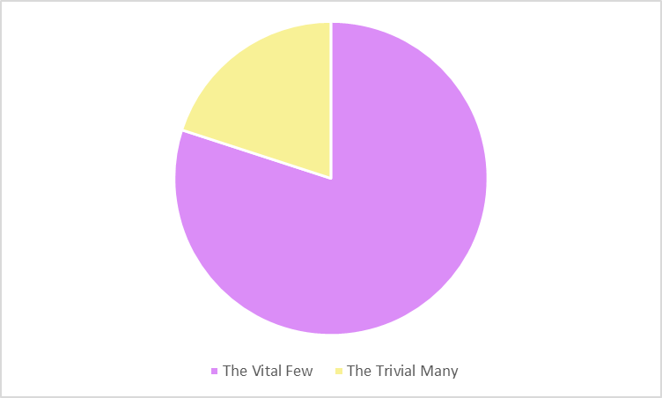
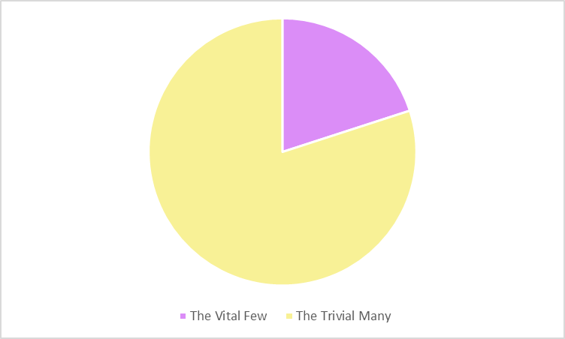
EDA and Data Cleaning
Customer and Social Analytics
Data cleaning steps
Total = Unit Price * Quantity
Dropped all countries other than United Kingdom
Dropped rows with negative Quantity
Removed Outliers using z-score
Pareto Principle
Top 20% of the customers are responsible for 70% of the total revenue

Slide 5



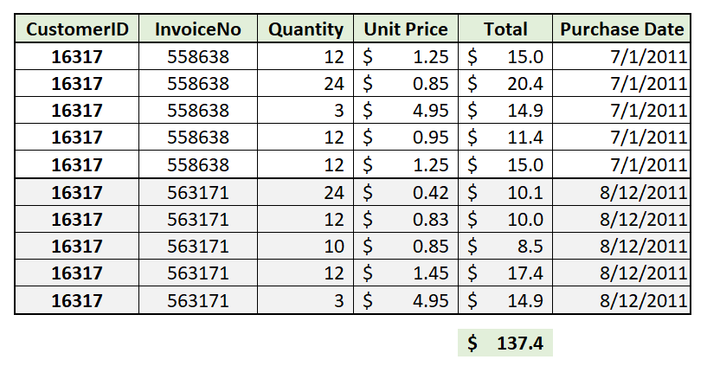
What is RFM?
Customer and Social Analytics
Recency
How recent was the last purchase?
Aids in understanding how engaged/ interested the customer is in a company
Frequency
How many purchases have been made?
Aids in understanding how frequently the customer would make a purchase
Monetary
What is the value of purchase?
Aids in understanding willingness to spend
Assume Current Date = 12/10/2011
Recency = 12/10/2011 – 8/12/2011 = 120 days
Frequency = 2
Monetary = $137.4

Slide 6
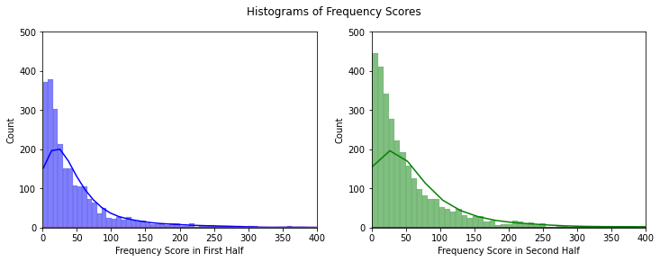
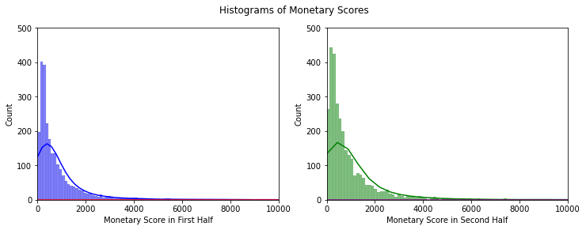
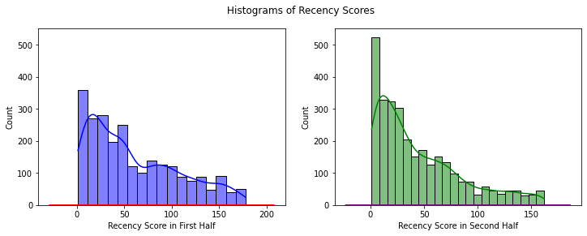
RFM on Sales Data
Customer and Social Analytics
Store Sales Data from 12/01/2010 to 12/09/2011
First Half
Second Half
12/1/2010
1/1/2011
7/1/2011
12/9/2011
We are spitting the data into two halves to isolate the effects of holiday season in RFM scoring

Slide 7
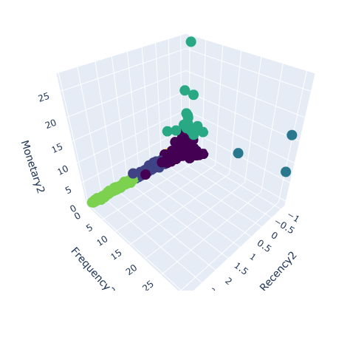
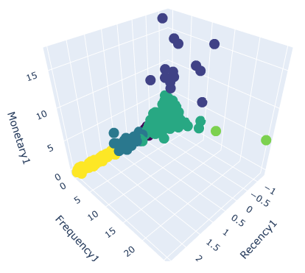
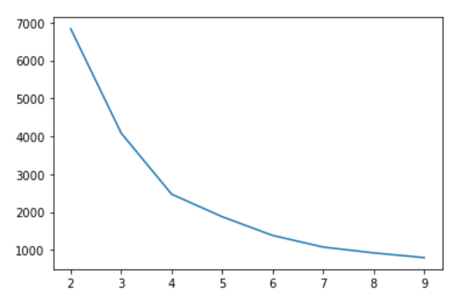
Clustering
Customer and Social Analytics
K-means clustering is sensitive to the scale. The data is normalized using StandardScaler.
Optimal Number of clusters are 6.

Slide 8
Segments and Strategy
Customer and Social Analytics
Customer Segments
Champions
Divas
Loyalists
Low-Value
At-Risk
Hibernators
At-risk customers
Give them directed offers such as, coupons and discounts.
Give them some personalized recommendations
Loyalists
Exclusive offers and reward points
Community Building featuring customer stories.
* The segments are statistically different from each other

Slide 9
Future Scope and Limitations
Customer and Social Analytics
Limitations
Sales data for December 2011 is not available for RFM analysis in second half
Lack of customer information such as location and occupation
Inability to capture customer experience
Inability to account for external factors
RFM scores needs to be frequently refreshed
Future Scope
RFM scoring can be done at product category level to capture the impact of the product’s shelf-life
The project can be scaled by incorporating customer level information with RFM scores
The RFM model can be used to optimize marketing efforts across multiple channels by identifying the most effective channels for reaching different customer segments

Slide 10

Customer and Social Analytics
Q&A
How can we help you?

Slide 11
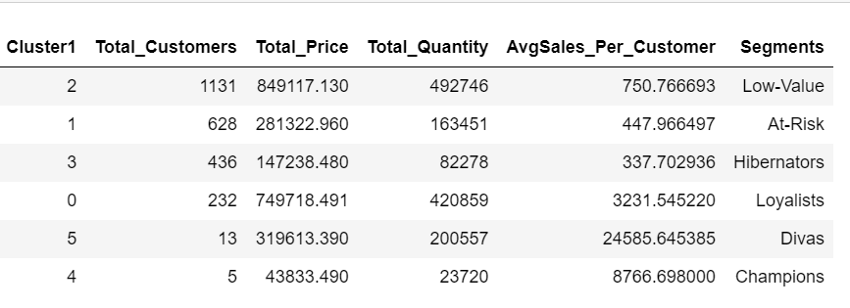
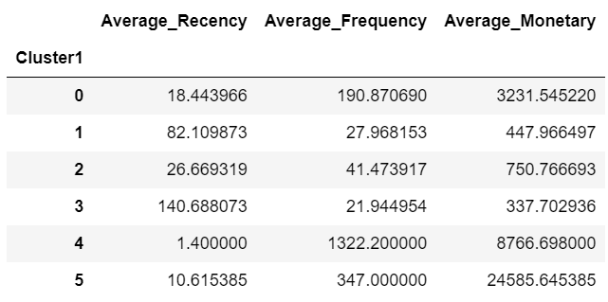
Appendix
Customer and Social Analytics

